Slide 1
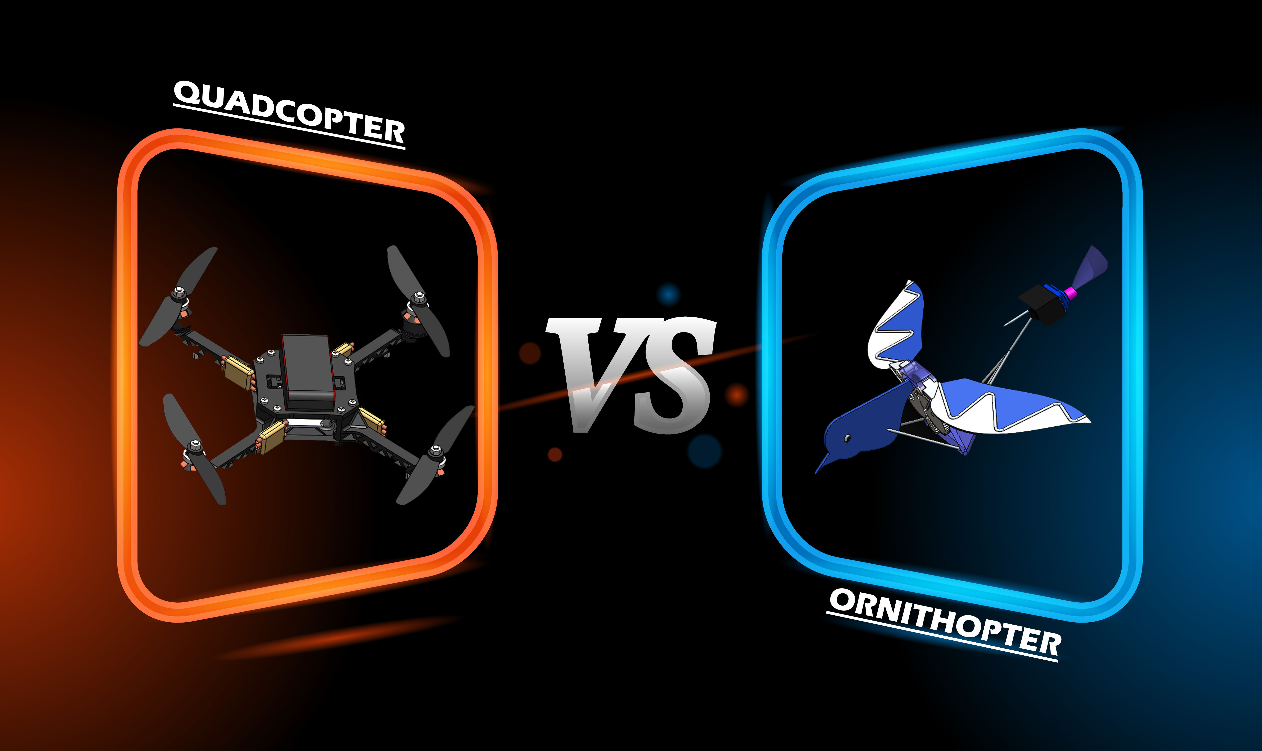

Slide 2
MANUFACTURING PROCESSES ENGINEERING METTALURGY LAB SESSION 2021-2022
TA201P
GROUP PROJECT
QUADCOPTER
ORNITHOPTER
Instructor: Prof. Shashank Shekhar
Tutor: Prof. Shikhar Jha
Lab I/C: Mr. I.P. Singh
Teaching Assistant: Md. Redad Mehdi
GROUP-4
SECTION-6

Slide 3
CONTENTS
ABSTRACT
QUADCOPTER
ORNITHOPTER
ISOMETRIC AND ORTHOGRAPHIC PROJECTION OF ASSEMBLY WITH DIMENSION
ISOMETRIC AND ORTHOGRAPHIC PROJECTION OF MAJOR PARTS WITH DIMENSIONS
MATERIALS USED
MANUFACTURING PROCESS
CAD OF ASSEMBLY
SIMULATION
COST ANALYSIS
ISOMETRIC AND ORTHOGRAPHIC PROJECTION OF ASSEMBLY WITH DIMENSION
ISOMETRIC AND ORTHOGRAPHIC PROJECTION OF MAJOR PARTS WITH DIMENSIONS
MATERIALS USED
MANUFACTURING PROCESS
CAD OF ASSEMBLY
SIMULATION
COST ANALYSIS
COMPARISON ON THE BASIS OF:
PHYSICAL APPEARANCE
MECHANICS INVOLVED
USES

Slide 4
ABSTRACT
DRONE MODELS
QUADCOPTER & ORNITHOPTER
This work belongs to the lab project for the TA201 course,
in which we have created a static replica of two different
drones, "quadcopter and ornithopter”.
The inspiration is, the growing demand for drones in every
field of human life , from defense purposes to amazon
goods delivery purposes.

Slide 5
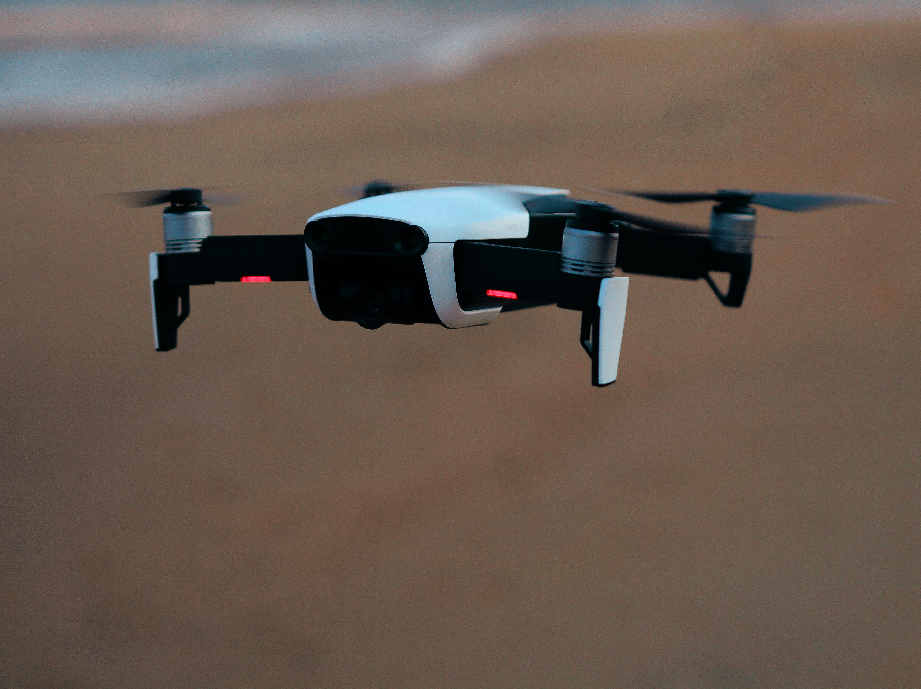
QUADCOPTER

Slide 6

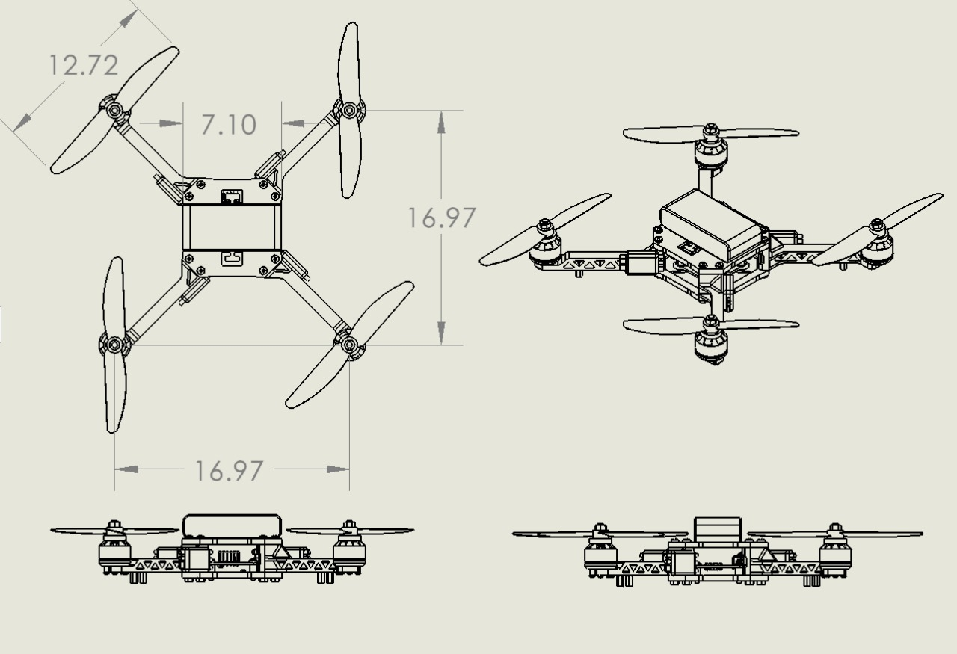
Quadcopter: Orthographic and Isometric Projection of Quadcopter Assembly
DIMENSIONS ARE IN INCHES

Slide 7
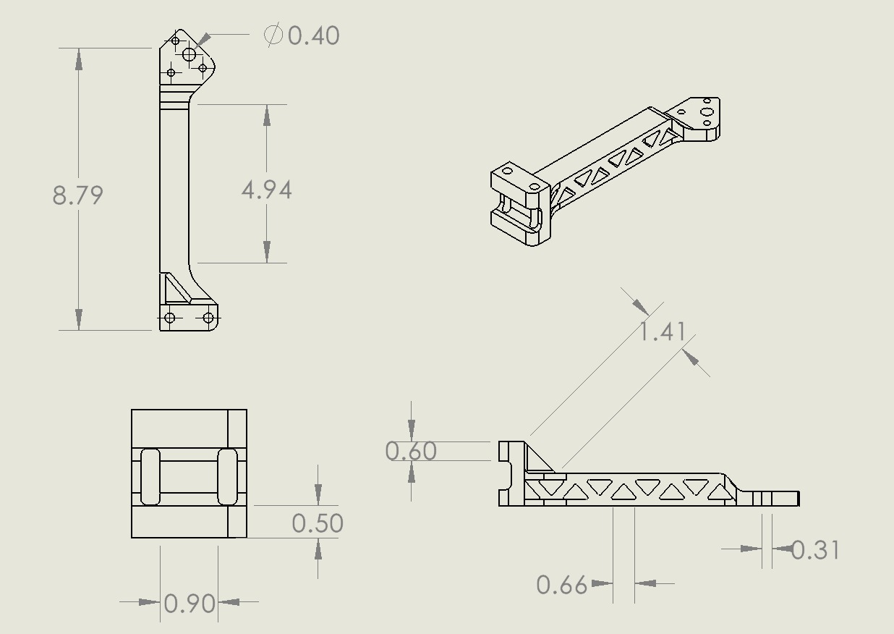
Quadcopter: Orthographic and Isometric Projection of Arm
DIMENSIONS ARE IN INCHES

Slide 8
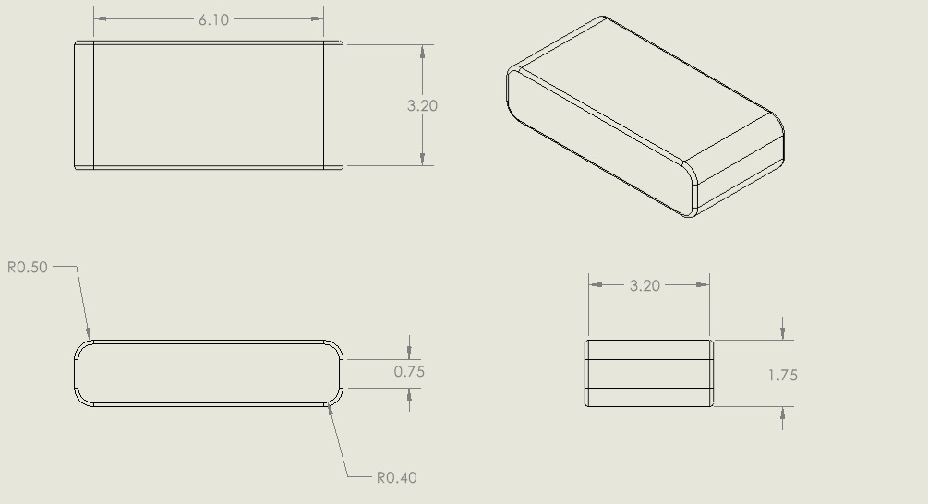
Quadcopter: Orthographic and Isometric Projection of Battery
DIMENSIONS ARE IN INCHES

Slide 9
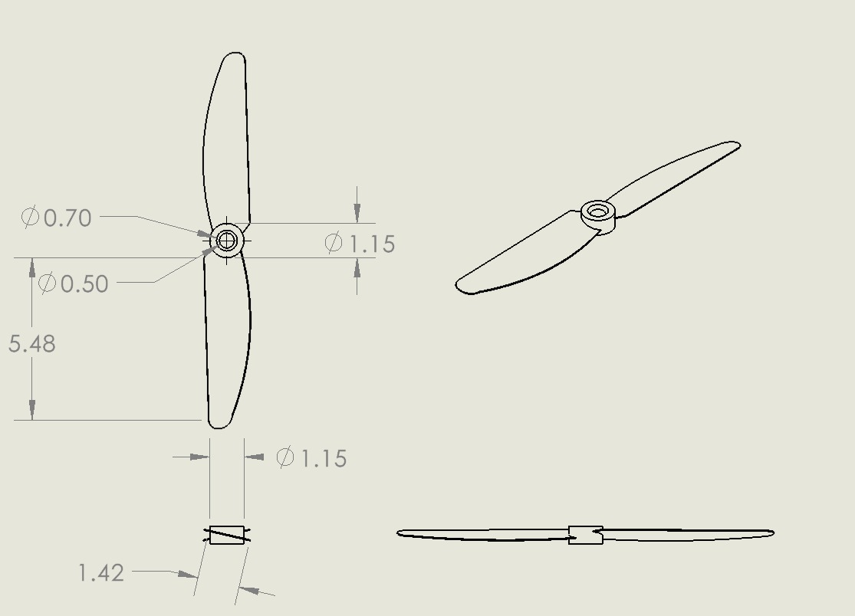
Quadcopter: Orthographic and Isometric Projection of Blade
DIMENSIONS ARE IN INCHES

Slide 10
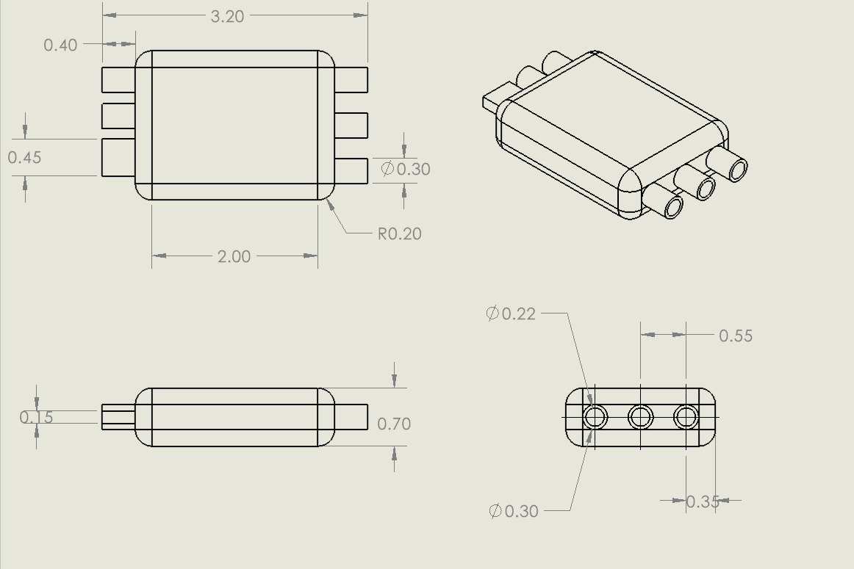
Quadcopter: Orthographic and Isometric Projection of ESC
DIMENSIONS ARE IN INCHES

Slide 11
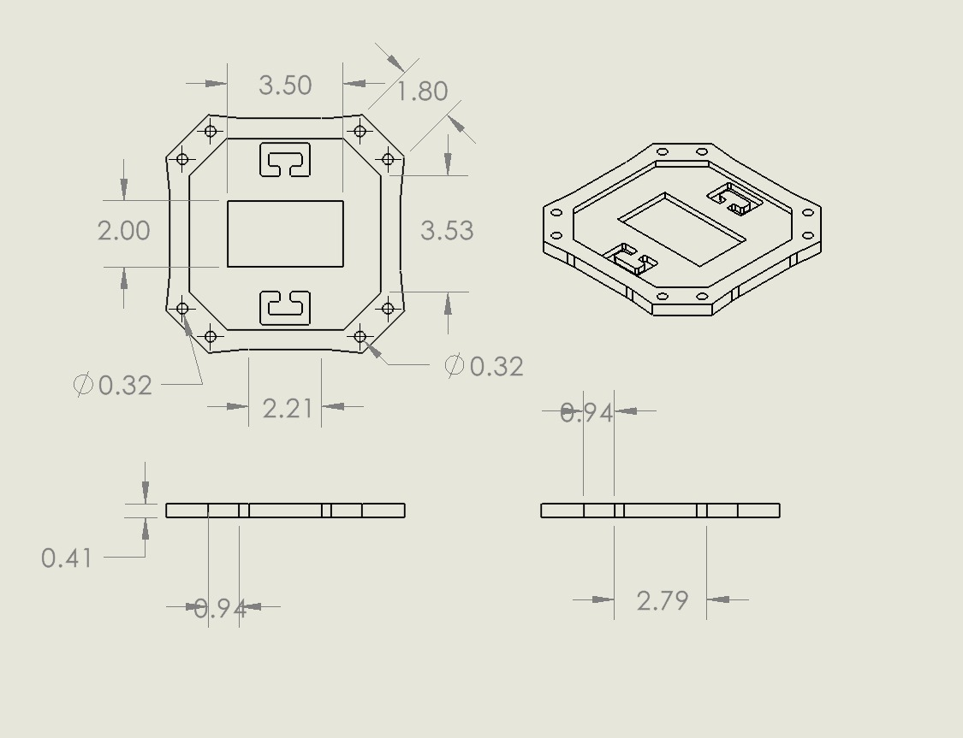
Quadcopter: Orthographic and Isometric Projection of Upper Base
DIMENSIONS ARE IN INCHES

Slide 12
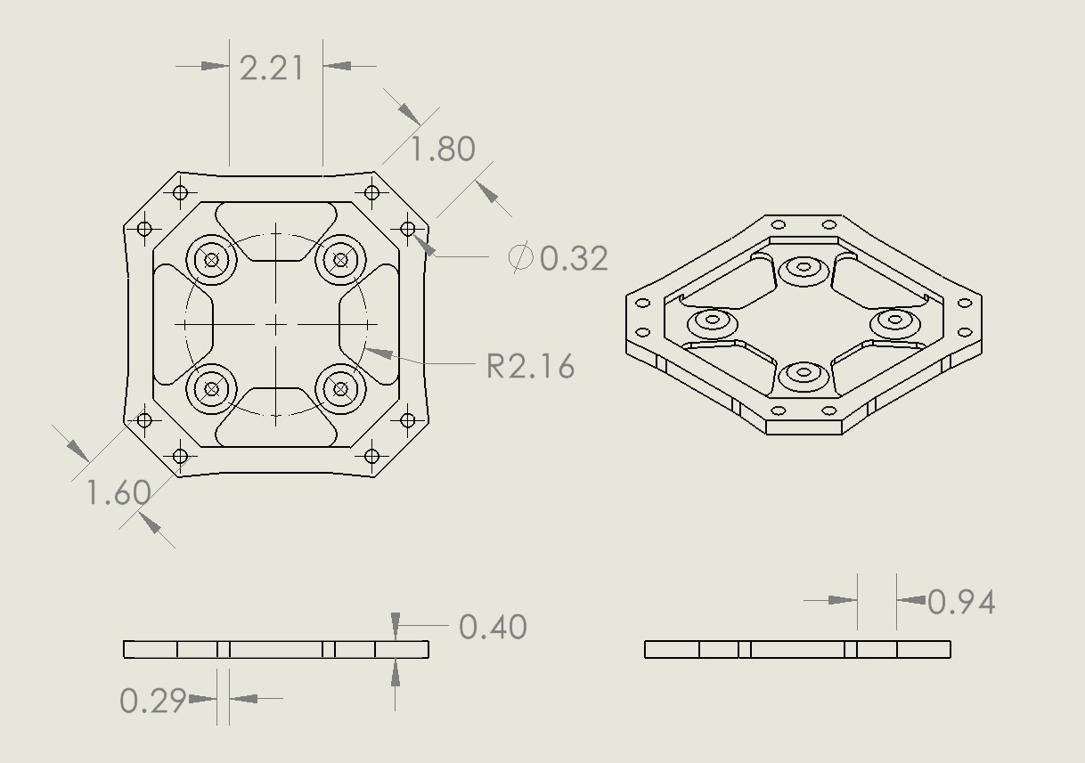
Quadcopter: Orthographic and Isometric Projection of Lower Base
DIMENSIONS ARE IN INCHES

Slide 13
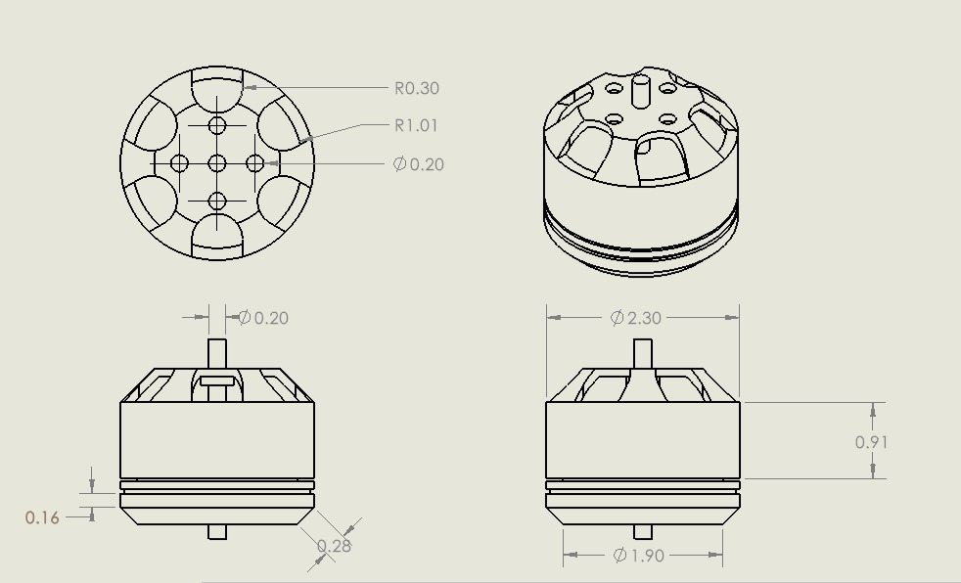
Quadcopter: Orthographic and Isometric Projection of Motor
DIMENSIONS ARE IN INCHES

Slide 14
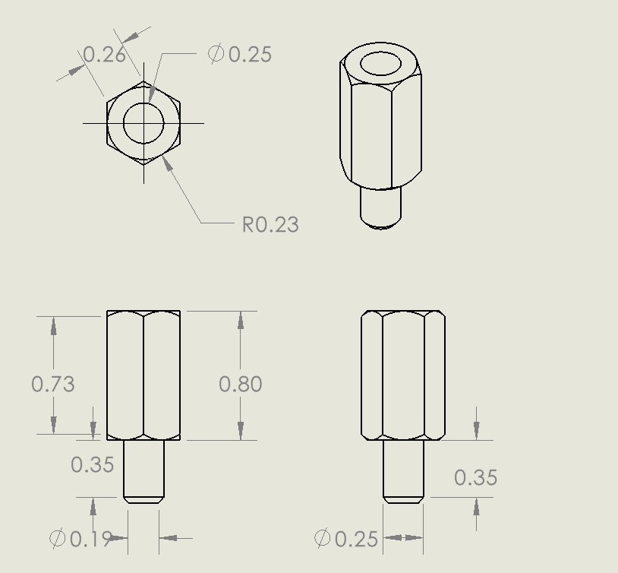
Quadcopter: Orthographic and Isometric Projection of Pillar
DIMENSIONS ARE IN INCHES

Slide 15
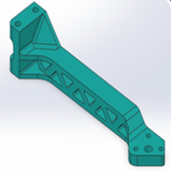
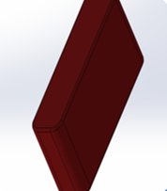
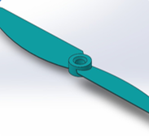
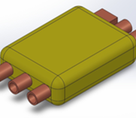
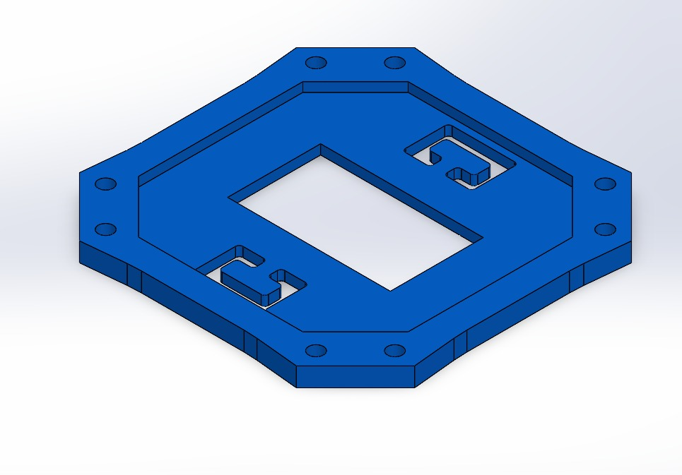
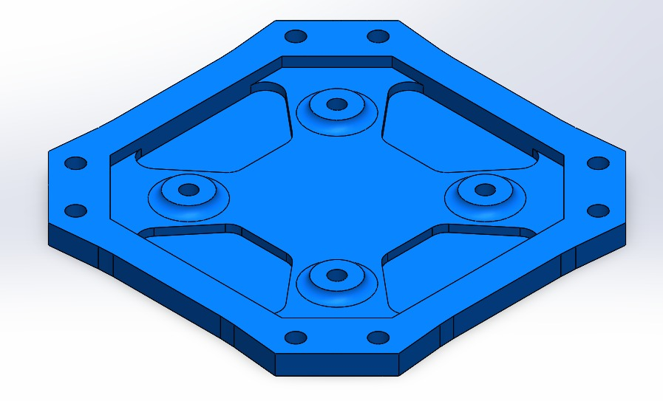
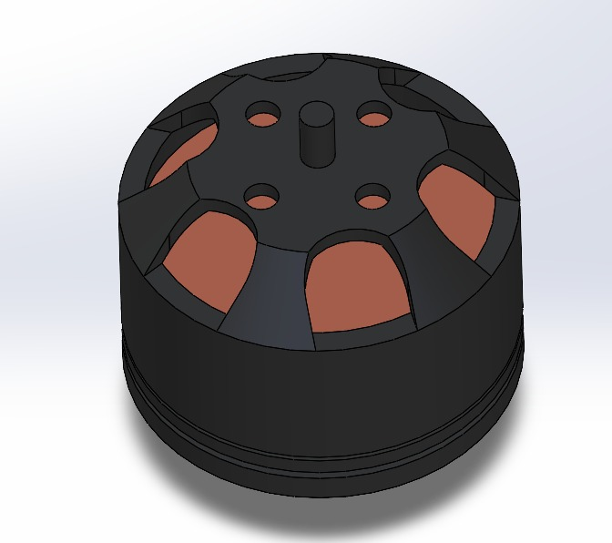
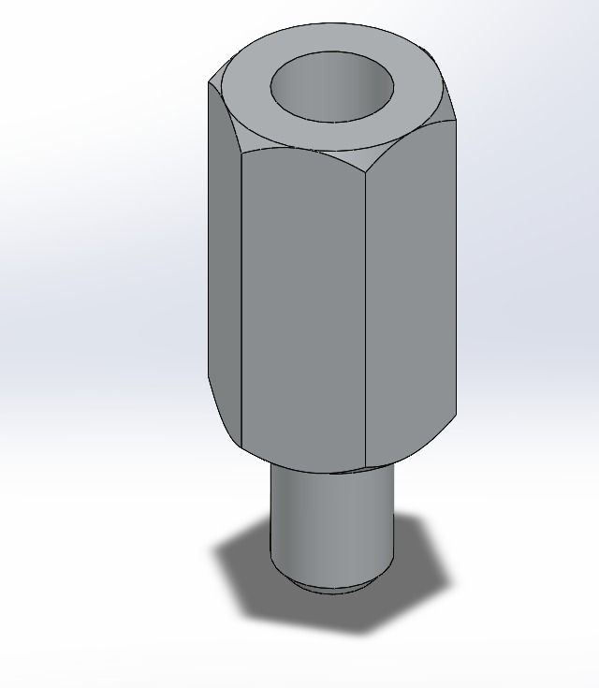
MATERIAL USED
NAME OF COMPENENT | MATERIAL(S) USED
ARM x4 | CAST IRON, THERMOCOL
BATTERY | THERMOCOL, SANDPAPER
BLADE x4 | STEEL SHEET, MILD STEEL ROUND PIPE
ESC x4 | THERMOCOL, MILD STEEL ROUND PIPE
UPPER BASE | METAL STEEL SHEET, THERMOCOL
LOWER BASE | METAL STEEL SHEET, THERMOCOL
MOTOR x4 | MILD STEEL SHEET
PILLARS x4 | CAST IRON, THERMOCOL

Slide 16
Manufacturing process
ARM​
BATTERY​
Cutting : to get thermocol in desired cuboidal shape ​
Fillet : to get rounded edges
Casting: Since the structure is rather complex we will cast it and use (wooden/thermocol) triangular prism as core.​

Slide 17
Manufacturing process
BLADE
Take a steel sheet and cut it into required size.​
ESC​
Thermocol used as substitute for electronic component: ​
Bend it into required shape by holding one end by pliers.
Cutting : to get thermocol in desired cuboidal shape ​
Fillet : to get rounded edges​
Heating : Steel rod is heated to make it easily penetrate across the thermocol bar from one end to another​.
Join it with steel round pipe by adhesion

Slide 18
Manufacturing process
UPPER BASE​
LOWER BASE​
We will use three metal sheets of varying thickness and cut them into the required shape.​
Join the two sheet via adhesive joining while keeping thermocol in between to increase thickness
We will join the three sheets via adhesive joining while keeping two thermocol layers between two consecutive sheets.​
Lastly we will punch holes in the sheet at appropriate places.​
We will take two metal sheet of varying thickness and cut them into required shape.​
Punch holes of required shapes

Slide 19
Manufacturing process
MOTOR​
Cutting and Punching:- Cutting the thermocol, steel sheet and steel rod to required size and punch holes
Deep Drawing:- Making holes in steel sheet ​
Adhesion :- To join all the parts together
As the structure is complex, we will use casting with thermocol as core.
Pillar

Slide 20
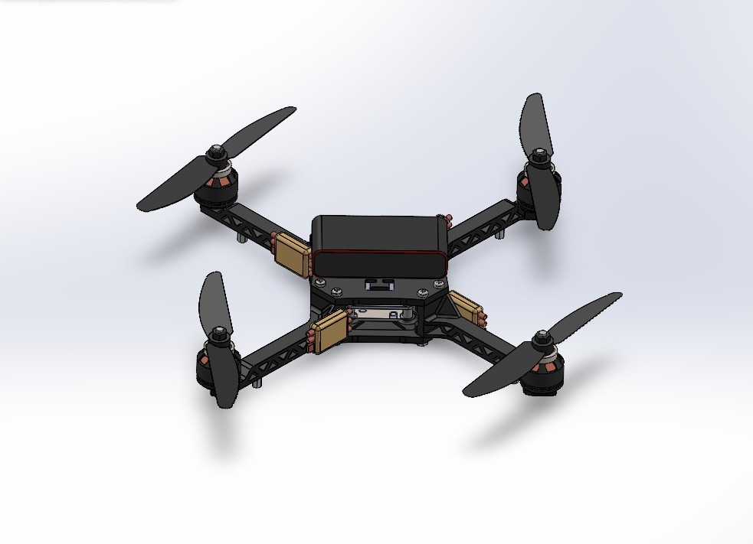
CAD OF ASSEMBLY

Slide 21
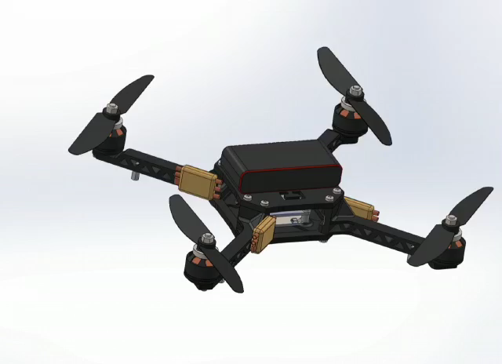
SIMULATION

Slide 22
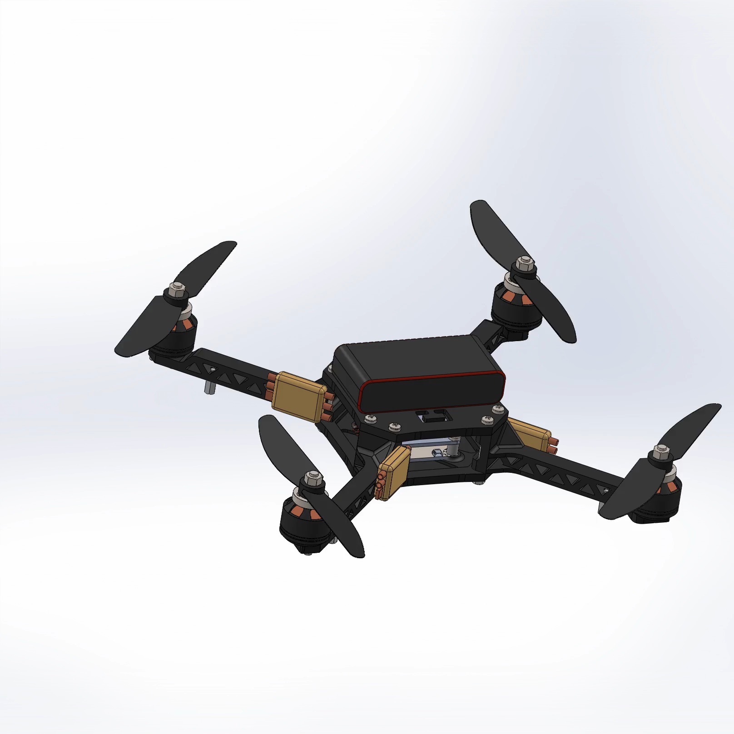
SIMULATION

Slide 23
COST ANALYSIS
S.no. | Material used | Size/ Quantity | Estimated Cost (in Rupees)
1. | Steel Sheet | 4ft x 8ft x 0.5mm | 780
2. | Mild Steel Sheet | 6ft x 10ft x 0.5mm | 230
3. | Mild Steel Round Pipe | Length 1 ft | 200
4. | Thermocol | 3ft x 8ft x 0.5inch | 50
5. | Mild Steel Square Rod | 15ft x 15ft | 60
6. | Sand Paper | 0.5ft x 0.5ft | 20
7. | Cast Iron | 1 kg | 70
7. | Cast Iron | 1 kg | 70
Total |  |  | 1530

Slide 24
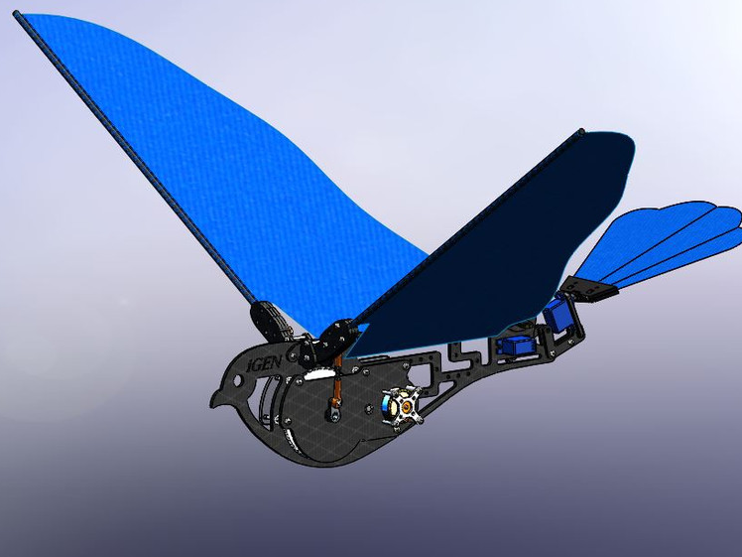
ORNITHOPTER

Slide 25
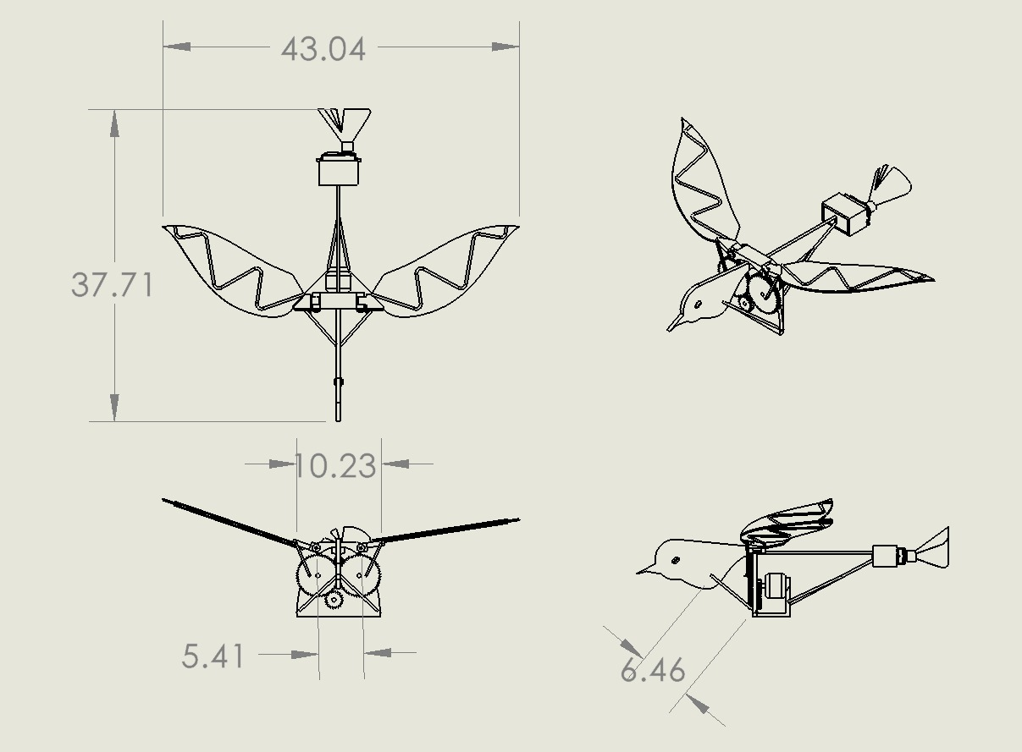
Ornithopter : Orthographic and Isometric Projection of Ornithopter Assembly
DIMENSIONS ARE IN CM

Slide 26
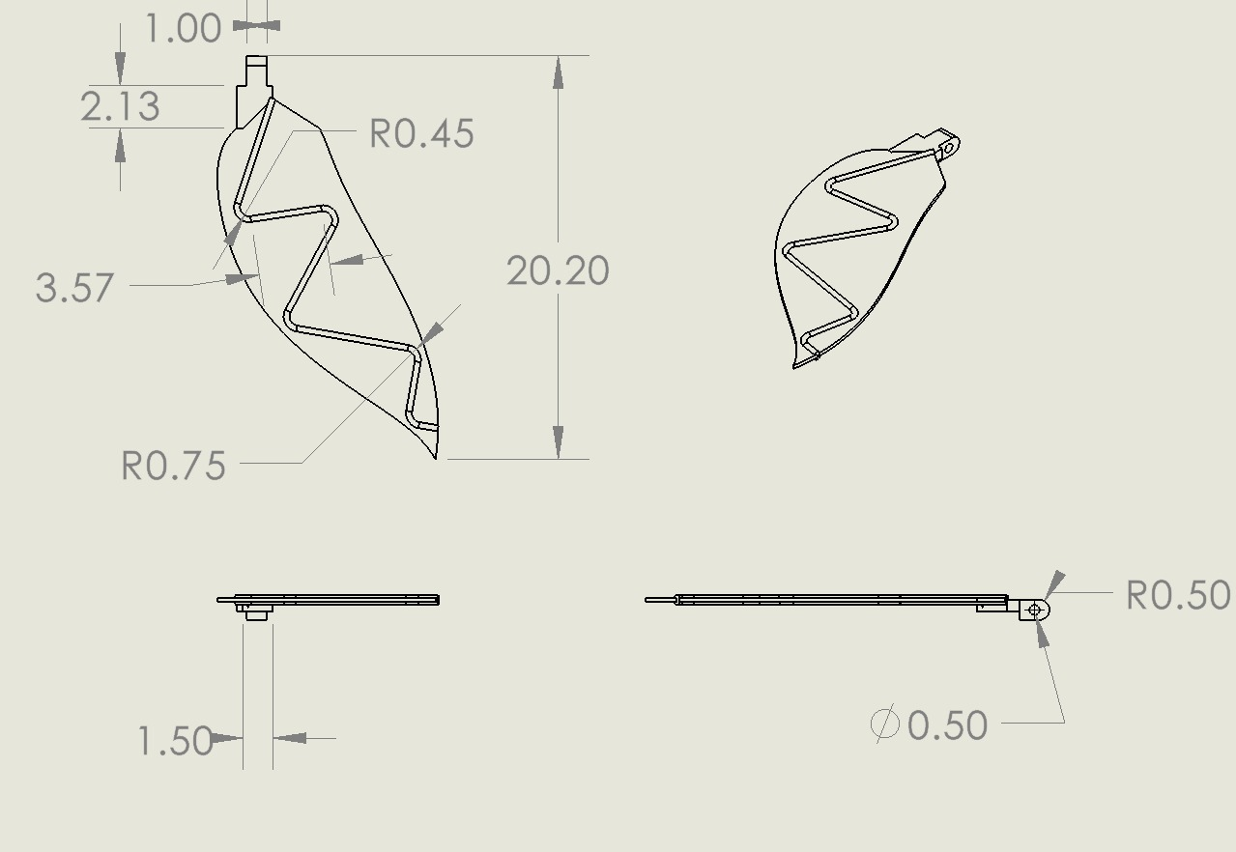
Ornithopter : Orthographic and Isometric Projection of Wing
DIMENSIONS ARE IN CM

Slide 27
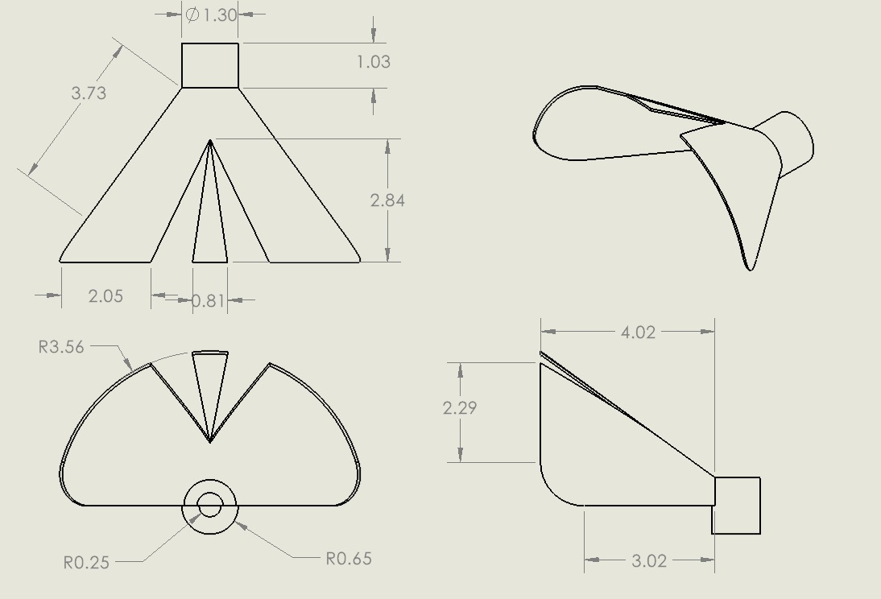
Ornithopter : Orthographic and Isometric Projection of Tail
DIMENSIONS ARE IN CM

Slide 28
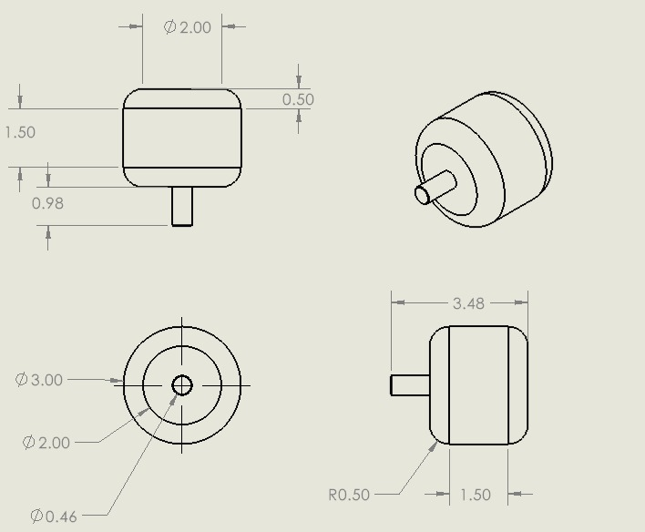
Ornithopter : Orthographic and Isometric Projection of Motor
DIMENSIONS ARE IN CM

Slide 29
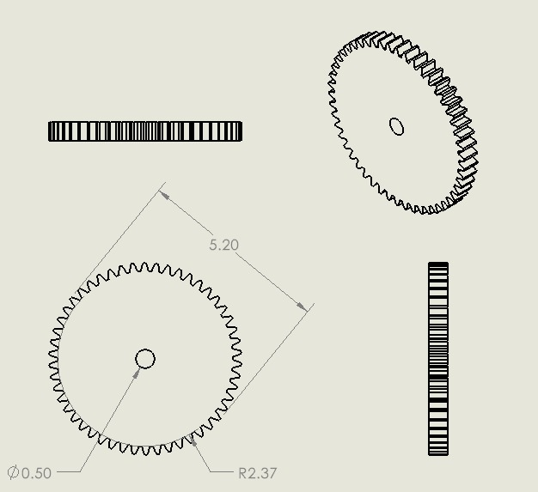
Ornithopter : Orthographic and Isometric Projection of Gear
DIMENSIONS ARE IN CM

Slide 30
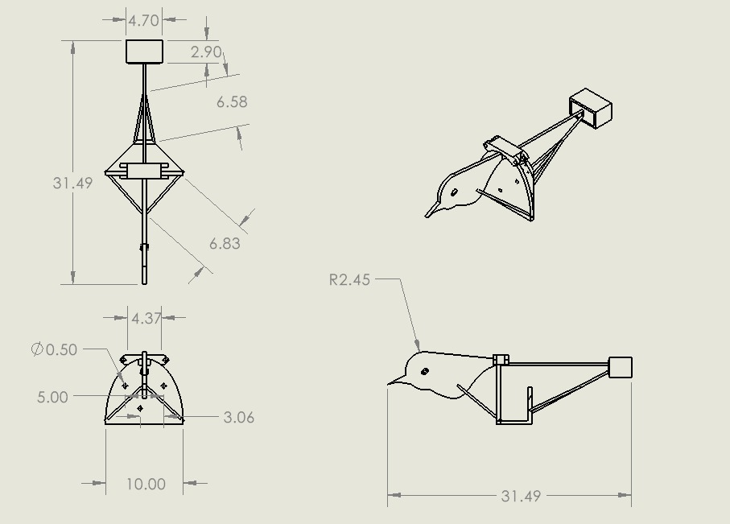
Ornithopter : Orthographic and Isometric Projection of Body
DIMENSIONS ARE IN CM

Slide 31
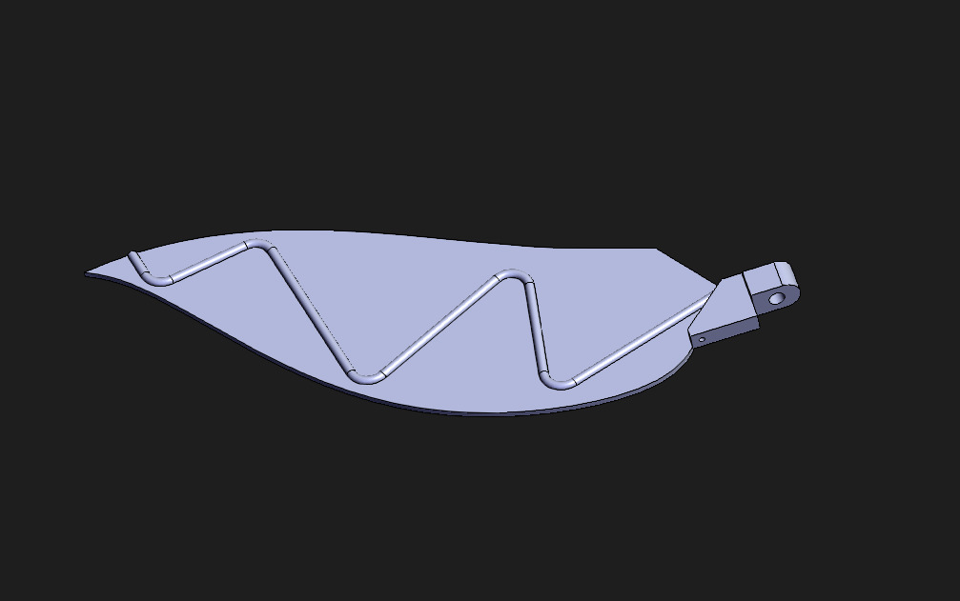
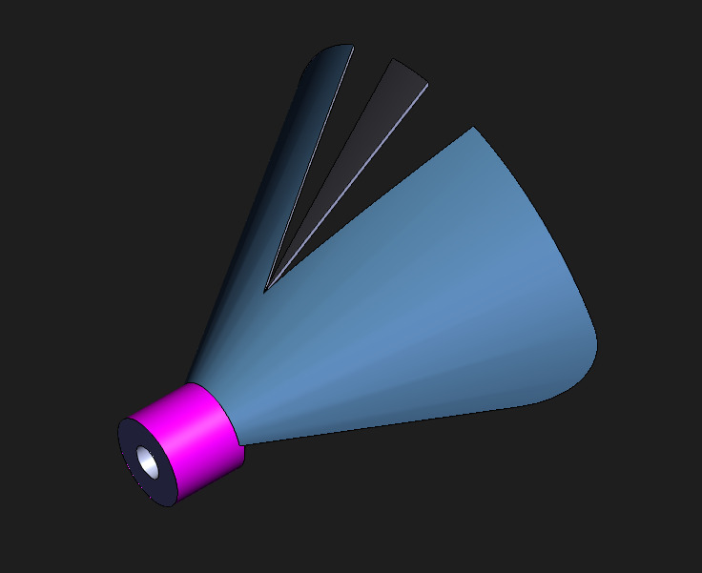
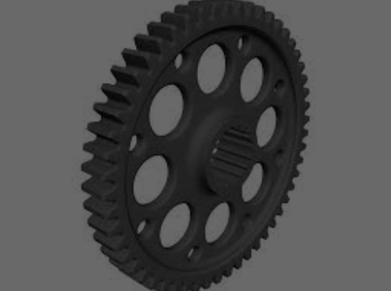
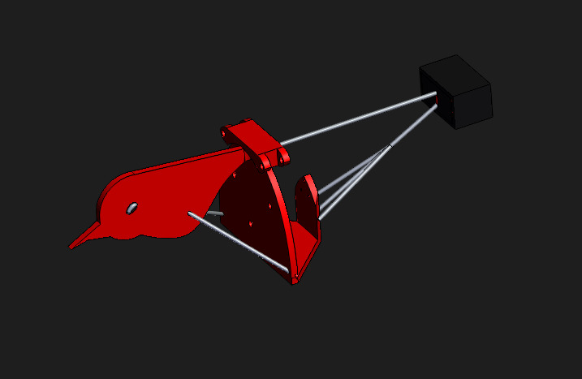
Material used
NAME OF COMPENENT | MATERIAL(S) USED
WING | THIN MILD STEEL SHEET, MILD STEEL SQUARE ROD, THIN MILD STEEL ROUND ROD
TAIL | MILD STEEL SHEET , MILD STEEL ROUND PIPE
MOTOR | MILD STEEL SHEET , THERMOCOL , THIN MILD STEEL ROD
GEAR | MILD STEEL DISC, THIN MILD STEEL ROUND ROD
BODY | MILD STEEL SHEET, THIN MILD STEEL ROUND ROD, BLACK GLASS, FEVICOL

Slide 32
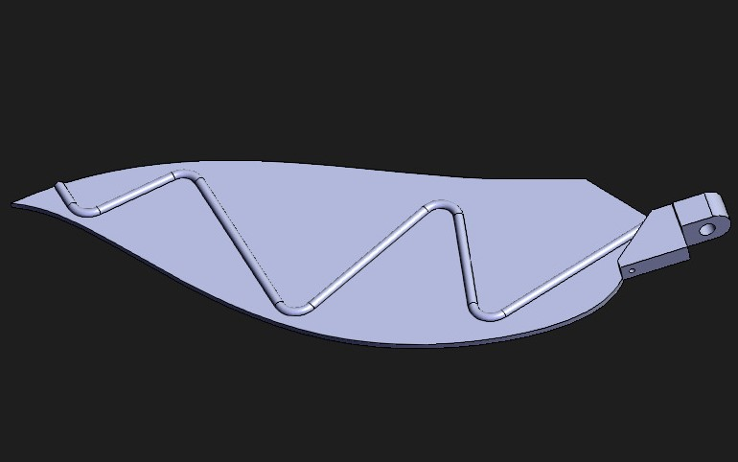
Manufacturing process
WING
Take metal sheet and cut it into required shape.
TAIL
Bend a mild steel sheet into the shape of funnel and cut it into required shape and size.
Bend a thin steel rod and use adhesive joining to join it with metal sheet
Cut a Steel square rod and drill a hole in it.
Join the steel square rod with metal sheet via adhesive/brazing/welding.
Cut a mild steel round pipe and join it with sheet via welding/adhesion.

Slide 33
Manufacturing process
MOTOR
Cutting and Punching:- Cutting the thermocol, steel sheet and steel rod to required size and punch holes
GEAR​
Take a mild steel disc and punch holes in it.​
Deep Drawing:- Making holes in steel sheet
Adhesion :- To join all the parts together
Using adhesive join a round steel pipe with disc.​
Create gear teeth using the process of gear shaving

Slide 34

Manufacturing process
BODY​
Use mild steel sheet and cut it into various required shapes.​
Join them using adhesive joining.​
Cut thin mild steel round rod into required size and join them using adhesion​
Use black glass bead as the eye and join via adhesion​ ​

Slide 35
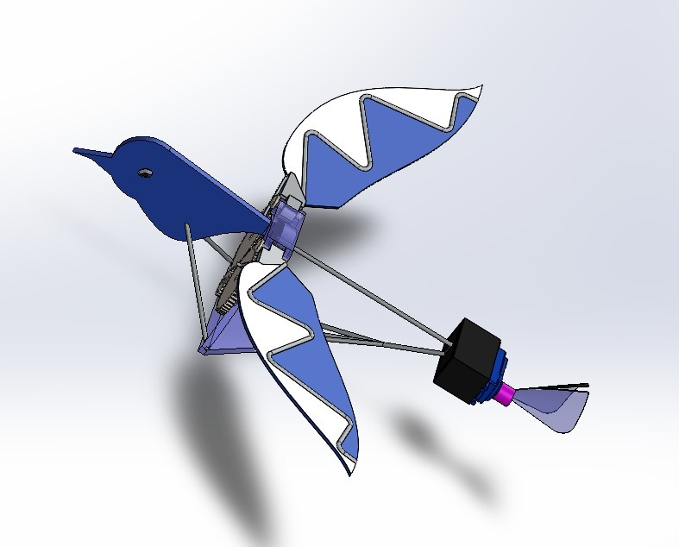
CAD OF ASSEMBLY

Slide 36
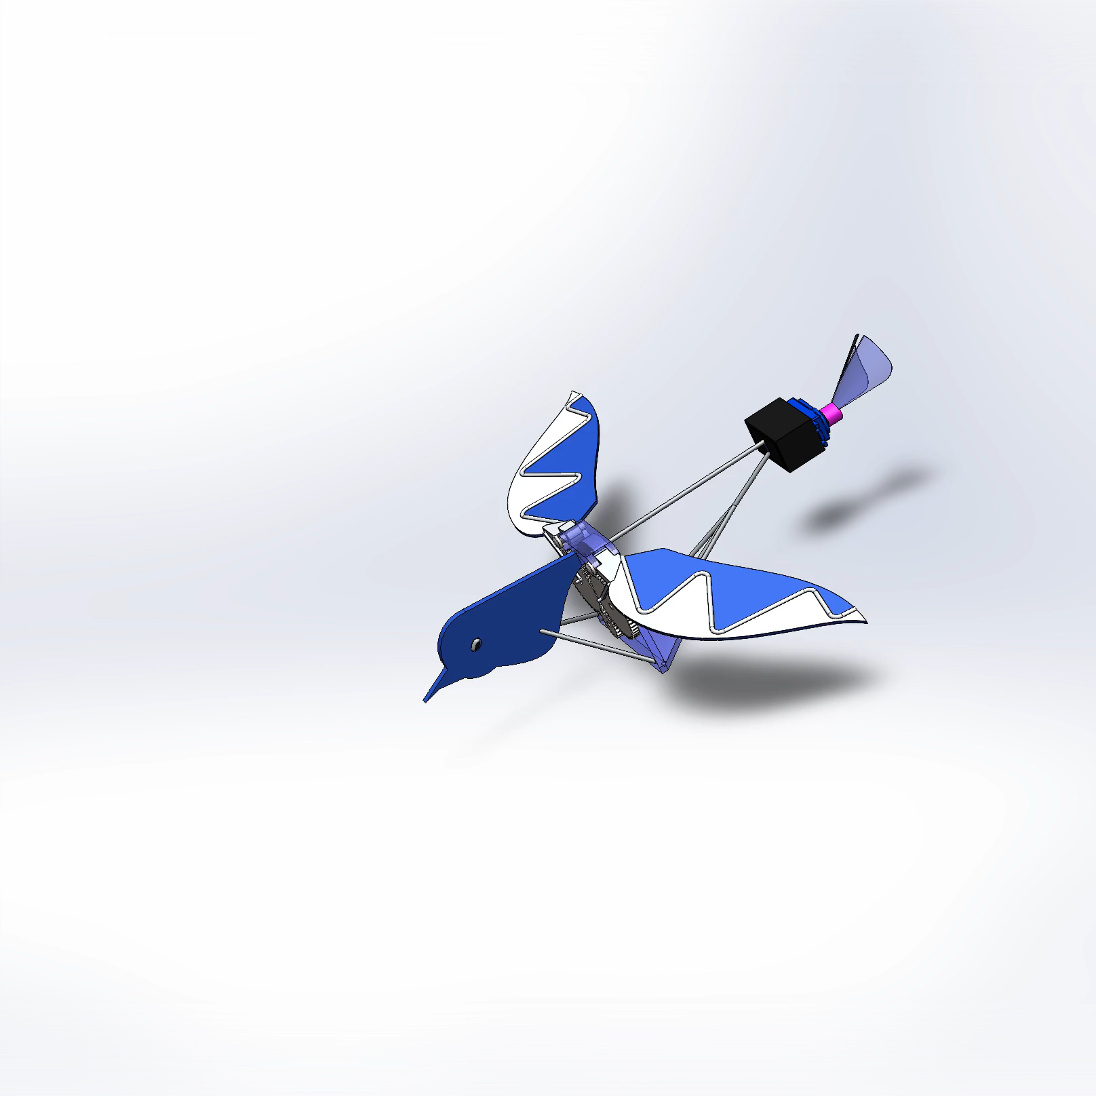
SIMULATION

Slide 37
COST ANALYSIS
S.no.​ | Material used​ | Size/Quantity​ | Estimated Cost (in Rupees)​
​ 1.​ | ​ Mild Steel Sheet​ | ​ 3ft x 6ft x 0.5mm​ | ​ 160
​ 2.​ | ​ Mild Steel Square Rod | ​ 15cm x 15cm x 5 | ​ 80
​ 3.​ | ​ Mild Steel Round Rod | ​ ​length 2ft | ​ 300
​ 4.​ | ​ Fevicol | ​ 4 tubes​ | ​ 20
​ 5.​ | ​ Thermocol | ​ 3ft x 3ft x 0.5inch | ​ 50​
​ 6.​ | ​ Mild Steel Disc | ​radius=6cm Width=1cm | ​ 60
TOTAL: |  |  | 670 (In Rupee)

Slide 38
COMPARISON
Physical Appearance
Quadcopter | Ornithopter
It uses its 4 rotors to get lift and thrust. | Its 2 wings serve the same purpose as a rotor providing the lift and thrust.
It has many complex electronic circuits involved. | It has simple design as compared to quadcopter.
It is made under the influence of helicopter. | Its structure is nothing but a replica of real life bird.

Slide 39
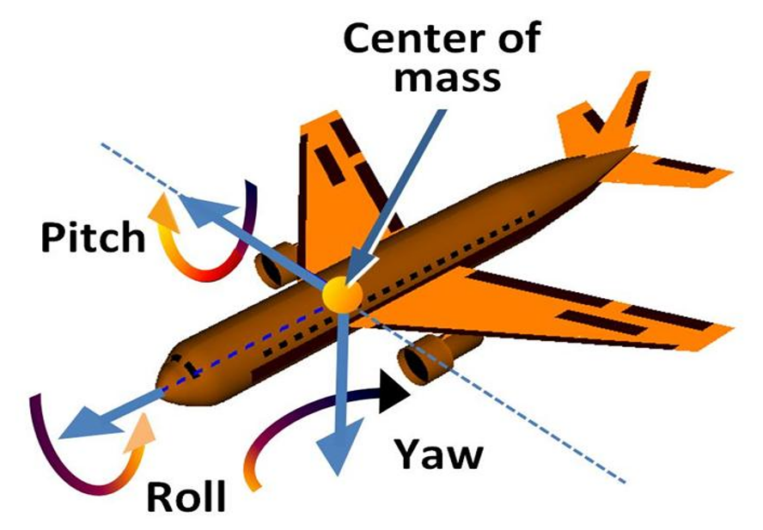
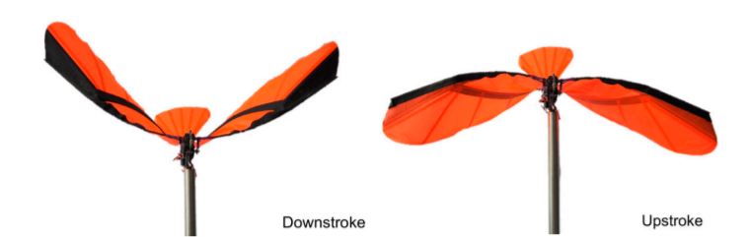
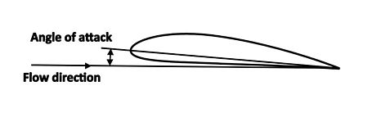
COMPARISON
Mechanics involved
Before moving to the physics behind the drones some basic terms to understand .

Slide 40
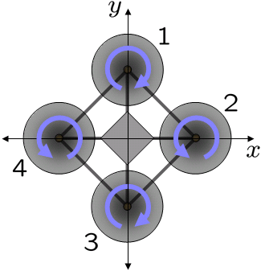
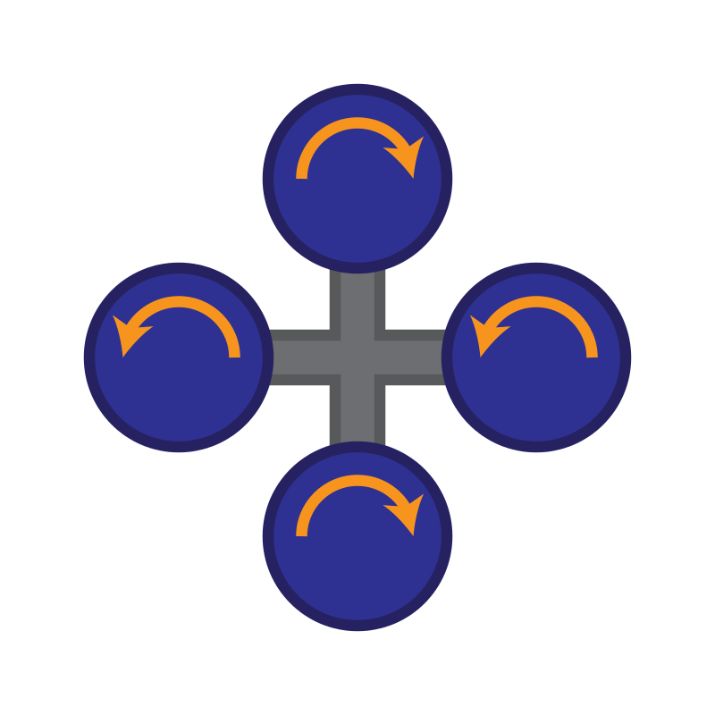
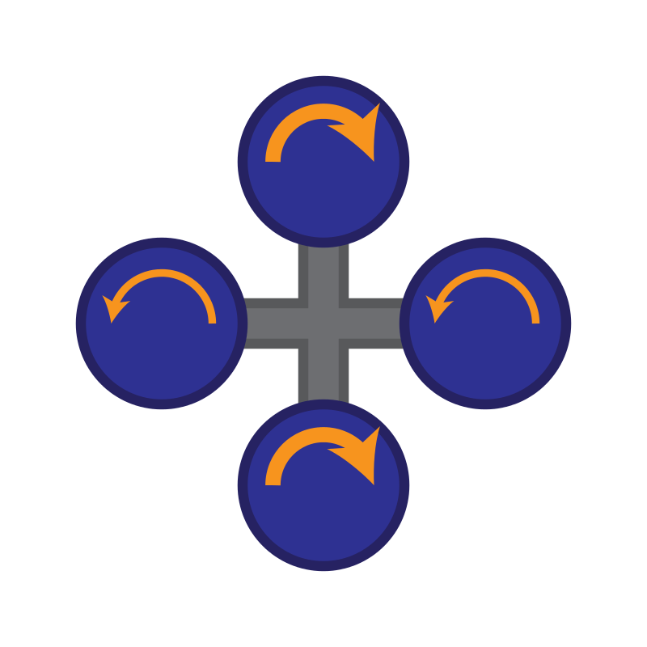
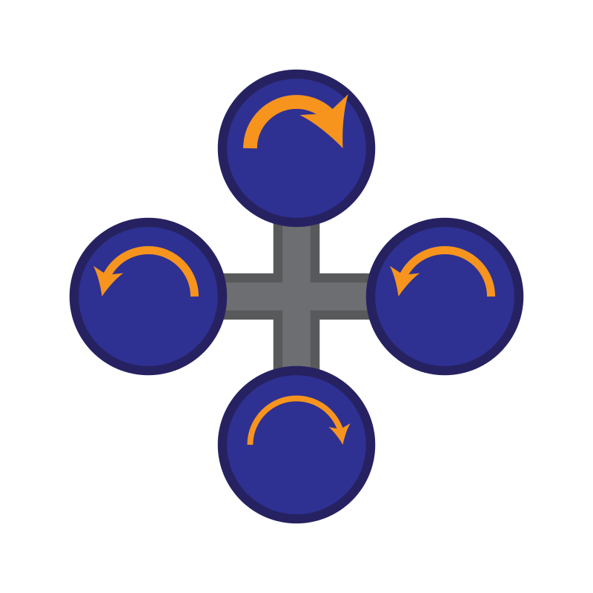
COMPARISON
Mechanics involved in Quadcopter
Rotors 1 and 3
spin in one
direction, while
rotors 2 and 4
spin in the
opposite direction
Adjusts its altitude by applying equal
thrust to all four
rotors
Adjusts its yaw by
applying more
thrust to rotors
rotating in one
direction.
Adjusts its pitch or
roll by applying more thrust to one rotor
(or two adjacent
rotors)

Slide 41
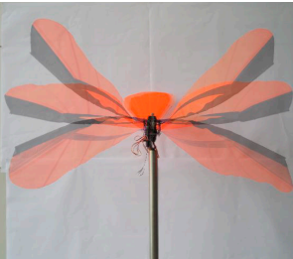
ORNITHOPTER
COMPARISON
Mechanics involved in Ornithopter
Snapshot of the wing at various
phases of the stroke cycle. This
demonstrates the changing wing
profile of the ornithopter.
It also make vertical take-off and
landing possible. It has been
suggested that these advantages
are greatest at small sizes and low
flying speeds.
Flapping wings offer potential
advantages in maneuverability and
energy savings compared with
fixed-wing aircraft.

Slide 42
COMPARISON
Uses
Quadcopter | Ornithopter
Used for aerial photography & videography. | Not used for normal photographic purpose ,only used while spying
Now-a-days commonly used for carrying payload by large companies i.e. Amazon. | Not suitable for carrying any load .
It can achieve a speed of 70mph, So it can reach desired location quickly | It is quite slow and usually its speed is just 15mph

Slide 43
OUR TEAM
ABHISHEK KUMAR BAITHA
ARYAN RAJ
BHAWANI SHANKAR
JANGA RAKESH KUMAR
MOHAMMAD MOSHIN
MRINAL KUMAR
RAGHAV KARAN
SHIVAM PANDEY
SPECIAL THANKS
CAD software SOLIDWORKS
Wikipedia
Aeromodelling Club IITK

